Slide 1
Dimensionality Reduction Review
LAURENS VAN DER MAATEN
ERIC POSTMA
JAAP VAN DER HERIK
2009
Dalyn McCauley

Slide 2
Outline
Dimensionality Reduction
Linear PCA
Non-linear techniques
Neighborhood-graph
Kernel Based
Manifold Learning
Computational Costs
Experiment Results

Slide 3
Dimensionality Reduction
Dimensionality Reduction
Is the transformation of high dimensional data into a meaningful representation of reduced dimensionality
Goal
Facilitate classification, visualization, compression and noise reduction of high dimensional data while maintaining data information and structure

Slide 4
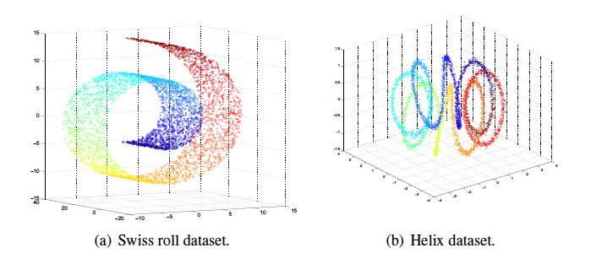
Dimensionality Reduction
Principal component analysis is the most common method but is not always the best choice
Non-linear techniques can deal with complex non-linear data

Slide 5
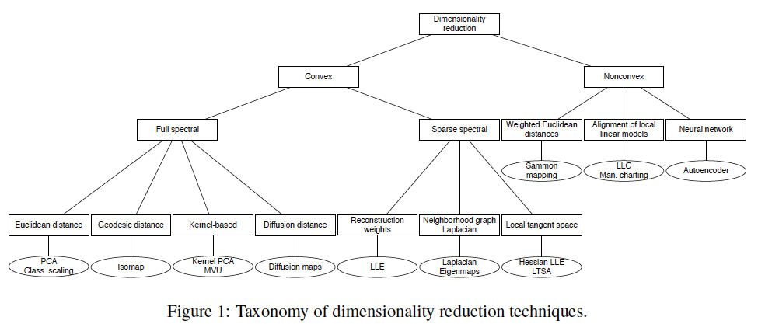

Slide 6
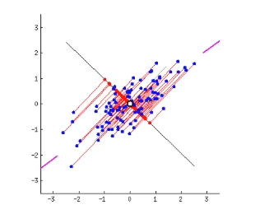
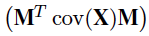
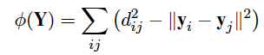

Traditional Principal Component Analysis
PCA – Finds a linear basis of reduced dimensionality for the data in which the amount of variance is maximal
Maximize variance:
Minimizing squared sum of errors:
Finds the linear mapping M that is defined by d principal eigenvectors of the covariance matrix. The new lower dimensional space Y is the product of the data matrix X and the linear mapping matrix M.

Slide 7
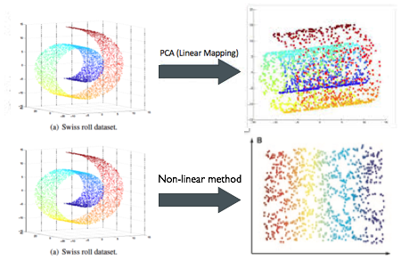
Drawbacks of linear PCa

Slide 8
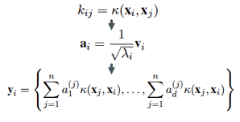
Kernel PCA
Kernel PCA – applies a kernel function to the data and then performs traditional PCA in the kernel space.
Gaussian Kernel, Polynomial Kernel, Linear Kernel (traditional PCA)
Computes the principal eigenvectors of the Kernel Matrix rather than the covariance matrix to find a non-linear mapping into the lower dimensional space.

Slide 9
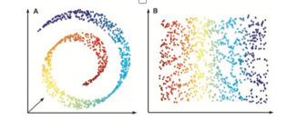
Isomap
Isomap techniques aim to preserve geodesic distances between data points rather than Euclidean
Useful for high dimensional data that lies on a curved manifold
The geodesic distances between a data point and it’s k-nearest neighbors is computed and forms a geodesic distance matrix to which classical scaling is applied.

Slide 10
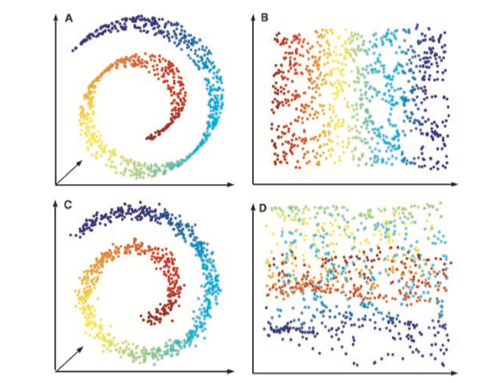
ISOmap
Weaknesses
Prone to short circuiting
Highly effected by noise in the data
Short Circuiting
Effect of noise

Slide 11
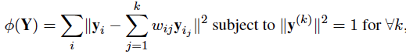
Local linear embedding (lle)
Maintain local topology of manifold
Construct a neighborhood map around xi
Calculate a local linear weights between point and k-nearest neighbors, w
Apply linear weights to reconstruct neighbors in low dimensional space Y
Minimize the cost function

Slide 12
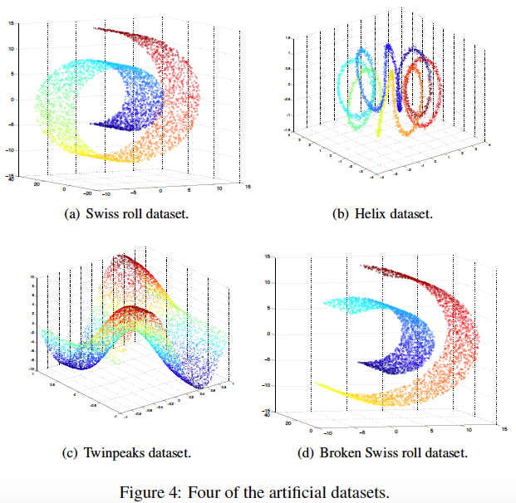
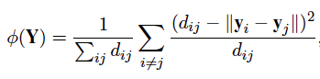
Sammon mapping
Sammon mapping aims to minimize the corresponding pairwise distances in Y and X
Iteratively optimizes the cost function, initializing at random configuration of points and incrementally changing until minimized
Retains local structure of data by assigning equal weight to all pairwise distances
Mainly for visualization purposes

Slide 13
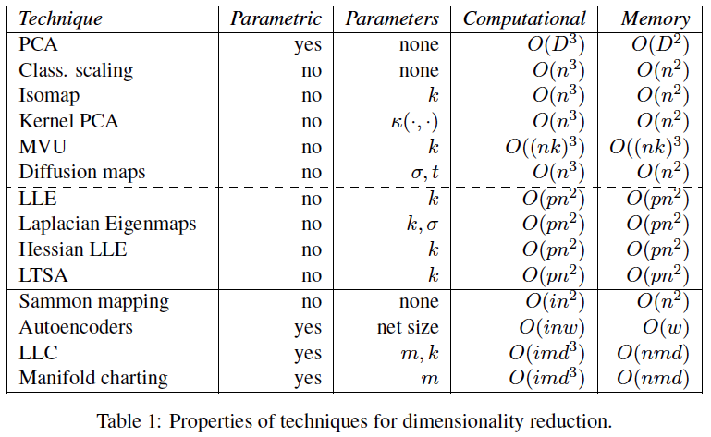
Computational cost
n - number of instances
D - data dimensionality
k - nearest neighbors
d - target dimensionality
P - ratio of nonzero elements
w - weighting component
m - models used
i - number of iterations

Slide 14
Experimental setup
Apply all 13 techniques to artificial datasets and natural datasets
Dataset | Description | Dimensionality
MNIST | Handwritten digits | D = 787
COIL20 | Object detection | D = 1024
NiSIS | Pedestrian detection | D = 648
HIVA | Drug discovery | D = 1617
Artificial Datasets
Natural Datasets

Slide 15
Comparison metrics
Generalized Error - generalization error of 1 nearest neighbor classifier that are trained on the lower dimensional set
Trustworthiness - evaluates the set of points that are among the k-nearest neighbors in the low dimensional space but not in the high dimensional space.
Continuity - evaluates the set of points that are among the k nearest neighbors in the high dimensional space but not in the low dimensional space.

Slide 16
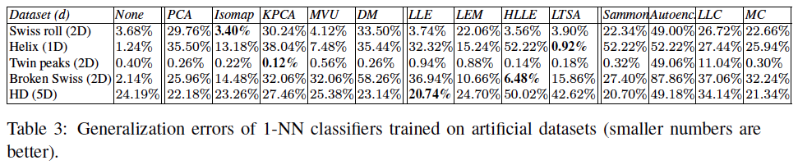
Performance on Artificial Datasets
Higher performers
Neighborhood graph techniques (Isomap, MVU, LLE, Laplacian Eigenmaps, LTSA, Hessian LLE)
Low performers
Technique that do not apply neighborhood graphs (PCA, Diffusion maps, Kernel PCA, Sammon Mapping)
Neighborhood based non-linear techniques out-perform PCA for artificial datasets

Slide 17
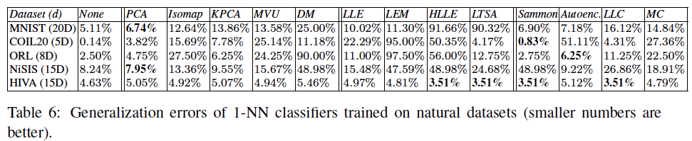
Performance on Natural Datasets
Higher performers
Techniques that do not apply neighborhood graphs (PCA, Sammon Maps, Autoencoders)
Low performers
Neighborhood graph techniques (Isomap, MVU, LLE, Laplacian Eigenmaps, LTSA, Hessian LLE)
Most non-linear techniques do not out-perform PCA for natural datasets

Slide 18
References
[1] M. Balasubramanian, “The Isomap Algorithm and Topological Stability,” Science, vol. 295, no. 5552, pp. 7a – 7, Jan. 2002.
[2]Y. Zhou and S. Sun, “Local Tangent Space Discriminant Analysis,” Neural Processing Letters, vol. 43, no. 3, pp. 727–744, Jun. 2016.
[3] https://blog.paperspace.com/dimension-reduction-with-lle/
[4] https://ryanlei.wordpress.com/2011/04/05/ammai_07-nonlinear-dimensionality-reduction-by-locally-linear-embedding/
[5] https://jlmelville.github.io/smallvis/mmds.html

